Slide 1
Current & future activities, focusing on Impact assessment framework F. D’Agresti, P. Francescangeli, G. Ruocco

Slide 2
Outline
Project activities
Milestones: list and achievements
Current tasks
First thoughts on the Assessment framework
Topics for discussion

Slide 3
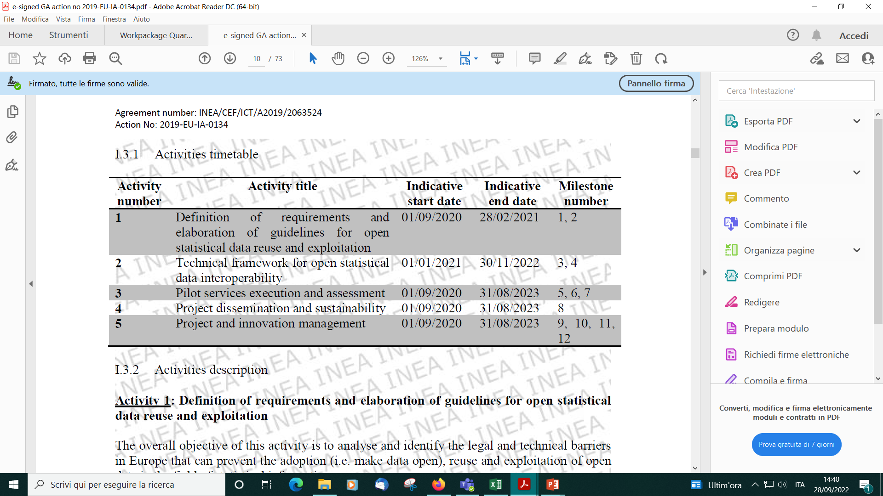
Project activities
Summary of activities and milestones

Slide 4
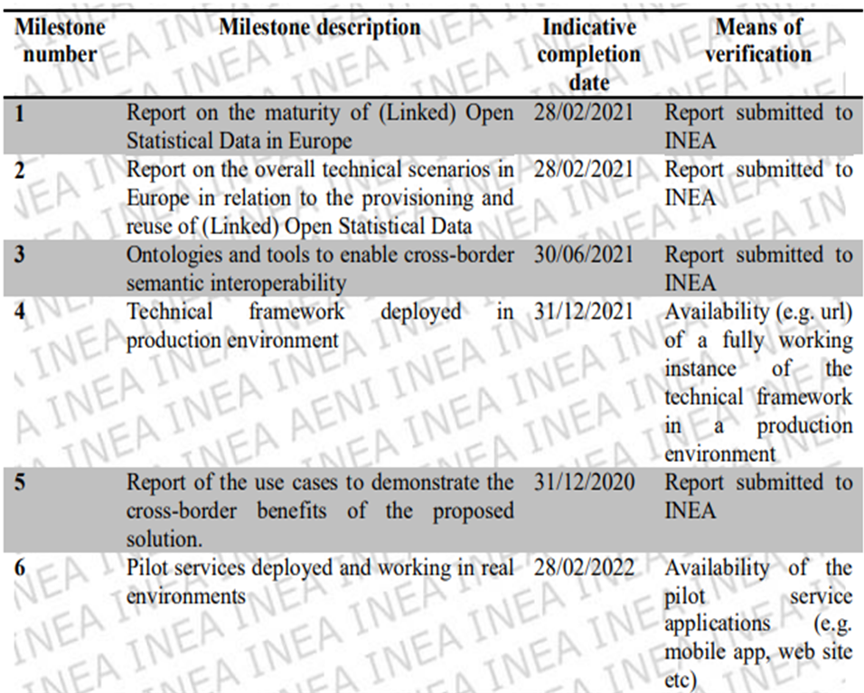
Milestones: list and achievements (1)
Reached Milestones
Activities 1-3

Slide 5
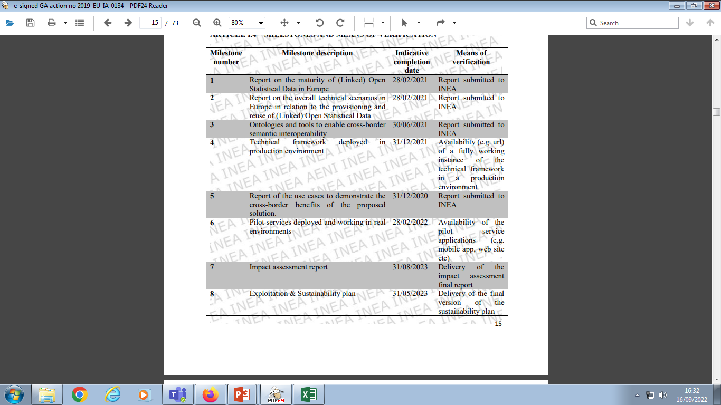
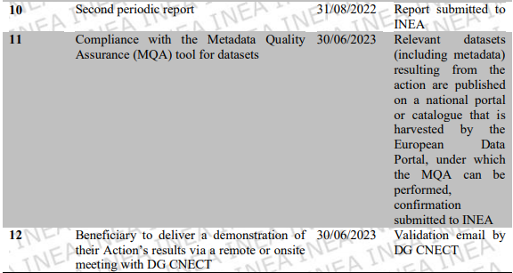
Milestones: list and achievements (2)
Milestones to reach
Activities 3-5

Slide 6
Milestones: list and achievements
Milestones to reach: indicative completion, connections and synergies
31/05/2023
30/06/2023
31/08/2023
Exploitation and sustainibility
plan
Compliance with MQA (Metadata Quality Assurance) tool for datasets
Impact assessment framework
Stakeholders support and involvement, project dissemination, recommendations
Assessment of compliance with MQA
Stakeholders, MQA, KPIs

Slide 7
Current Tasks (1)
Task 3.2 – Pilot services running and monitoring
This task will develop the overall monitoring framework for the pilot activities and support measures to ensure a successful execution of the services. The support measures will address technical issues related to the services and the INTERSTAT framework, but also functional and operational aspects such as stakeholder support. The pilot phase will be executed in two phases, allowing for the pilot applications to be updated in phase 2 in order to solve any bugs or implement new functionalities
What type of stakeholders should be supported?

Slide 8
Current Tasks (2)
Task 3.3 – Impact assessment
This task will define the methodology to assess the impact of the piloted innovative services and the benefits for the different stakeholders involved. The methodology will define processes and KPIs to measure the service impact from different point of views including, for instance, socio-economic benefits for citizens and business, and technical achievements in terms of open data provisioning, reuse and interoperability. Based on this methodology the task will perform the assessment of the impact of the outcomes of the Action, collecting and analysing the measurements related to the KPIs identified for each validation dimension

Slide 9
First thoughts on the Assessment framework (1)
Methodology: three main validation dimensions for impact assessment
Interstat framework tools – to assess Data pipelines
Compliance with MQA
Use cases assessment - to assess pilots architecture, mainly the Client applications and the implemented Front-end

Slide 10
First thoughts on the Assessment framework (2)
About Performance Indicators…
Performance indicators differ from business drivers and aims (or goals). KPIs should follow the SMART criteria:
The measure has a Specific purpose for the business, it is Measurable to really get a value of the KPI
The defined norms have to be Achievable, the improvement of a KPI has to be Relevant to the success of the organization and Time phased, which means the value or outcomes are shown for a predefined and relevant period
Source: https://en.wikipedia.org/wiki/Performance_indicator#Identifying_indicators_of_organization

Slide 11
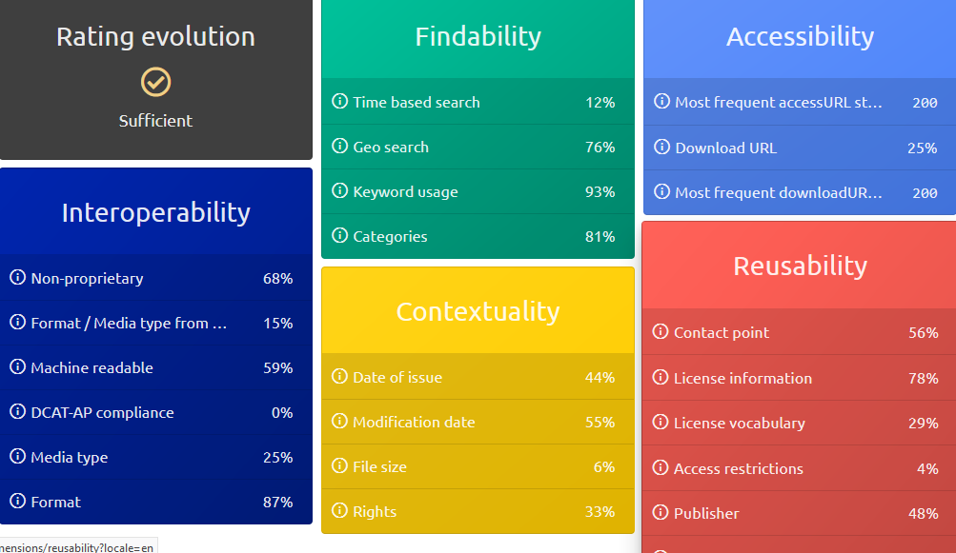
First thoughts on the Assessment framework (3)
About MQA…
The Metadata Quality Assurance is intended to help data providers and data portals to check their metadata against various indicators.
Source: https://data.europa.eu/mqa/?locale=en

Slide 12
Discussion topics
KPIs for the impact assessment
Validation dimensions | KPIs
Data pipelines | Back-end performances, Data pipeline completeness, tools shareability, service reuse, process reproducibility
Compliance with MQA | FAIR indicators, focus on Interoperability indicators: how to accomplish and improve them
Use cases assessment | User friendly interface, metadata, relevance of the selected topics

Slide 13
Discussion topics
Concerning stakeholders to engage…
Should we involve:
Representatives of international Data publishers?
Statistical domain experts?
Data users?
Name of the organization | Country | Mail
Center Bureau of Statistics (CBS) | Netherlands | m.jug@cbs.nl
Instituto Naciional de Estadistica y Geografia (INEGI) | Mexico | Juan.Munoz@inegi.org.mx
OECD |  | eric.anvar@oecd.org
Statistical Office Republic of Serbia (SORS) | Serbia | mira.nikic@stat.gov.rs
Office for National Statistics (ONS) | UK | eric.deeben@ons.gov.uk
Central Statistical Office (CSO) | Hungary | zoltan.vereczkei@ksh.hu
Statistics Sweden | Sweden | jakob.engdahl@scb.se
Statistics Norway | Norway | trygve.falch@ssb.no
StatCan | Canada | flavio.rizzolo@canada.ca
Statistical Office (SURS) | Slovenia | tomaz.speh@gov.si
DG Informatics | EU Commission | Emanuele.BALDACCI@ec.europa.eu
Unece |  | taeke.gjaltema@un.org

Slide 14
Discussion topics
Defining the overall results of the action from the stakeholder's perspective: will they access the Interstat framework tools to produce LOSD, or just navigate the pilot services implemented? Final recommendations are addressed to what type of stakeholders?
Finalizing Interstat framework and pilots for the impact assessment
Creating synergies between the project tasks to be accomplished, to avoid overlapping and benefit from activities interconnection

